Slide 1
Prepping, Testing, & Interpreting Data
MKTG 302-01
Spring Semester, 2025
Scott Beck

Slide 2
Student Learning Objectives
Ability to code your responses for easier tabulation during analysis
Review other ways to “clean” data
Discover ways to incorporate and analyze your findings into impactful research and consulting for your client
Application of Univariate and Multivariate Analyses in your overall review and presentation of your data (you will use both)

Slide 3
Reminder …
Apr 15 – 1st draft, lecture on reporting and measurement
Apr 17 – Easter Break – no classes
Apr 22 – Finish lecture on reporting and measurement
Work on Project in class
Apr 24 – Quiz #3
Apr 29 – 2nd draft (new date!)
Discussion with Burke, Inc. is cancelled!
Apr 30 – GABP Cincinnati Reds game and tour
May 1 – Wrap up Project!
May 6 – Presentation to Cincinnati Reds

Slide 4
EDITING
The inspection and correction of the data received from each element of the sample (or census).
Also called “cleaning”

Slide 5
Primary Tasks in the Editing Process
Convert all responses to consistent units
Assess degree of nonresponse
Where possible check for consistency across responses
Look for evidence that the respondent wasn’t really thinking about his or her answers
Verify that branching questions were followed correctly
Add any needed codes

Slide 6
CODING
The process of transforming raw data into symbols (usually numbers).

Slide 7
Coding Closed-Ended Items
What is your overall opinion of Uber?
unfavorable
favorable
(Typical coding: 1 2 3 4 5 6 7 )
Qualtrics does this for you automatically.

Slide 8
Important:
Make sure that you were consistent with low numbers (or high numbers) expressing good and high numbers (or low number) expressing bad.
Some times we switch the scale on a few items on purpose to make sure that people are paying attention. This is called “reverse coding”
To avoid confusion we often mathematically “switch” any reverse coded items before analysis
Take the number of items in the scale (7 in the previous slide) add 1, and then subtract the answer from this.
A 7 becomes a 1, 3 becomes a 5, etc.

Slide 9
Can fix the numbering in Qualtrics
This needs to be done BEFORE you download the data
Let me show you how….

Slide 10
Coding Closed-Ended Items: Check All That Apply
How did you learn about Brown Furniture Company? (check all that apply)
newspaper advertising
radio advertising
billboard advertising
recommended by others
drove by store
other: _______________
TYPICAL CODING:
6 different variables
(1 if checked; 0 if not)
(1 if checked; 0 if not)
(1 if checked; 0 if not)
(1 if checked; 0 if not)
(1 if checked; 0 if not)
(1 if checked; 0 if not)
Again, Qualtrics does this for you automatically, but if you export your data it is important to keep this in mind.

Slide 11
Coding Open-Ended Items
Factual open-ended items seeking concrete responses are relatively easy to code. Numeric answers are typically recorded as given by the respondent, while other types of responses are given a specific code number.
In what year were you born? (code year)
How many times have you ordered pizza from Domino's in the last month? (code number)
(3) Name the first 3 brands of coffee that come to mind. (code as 3 separate variables; assign numbers to represent each coffee shop mentioned)
Sometimes when you ask for a number, people will use words. You need to look for this and correct any occurrences.

Slide 12
Coding Open-Ended Items
Exploratory open-ended items seeking less structured responses are much more difficult to code.
In your own words, give us two or three reasons why you prefer to leave the state after graduation.

Slide 13
Process for Coding Exploratory Open-Ended Questions
Identify usable responses
Develop categories for responses
Sort responses into categories, using multiple coders; compare results
Assess the degree of agreement between coders
This is similar to what you did for your laddering interviews.
As with your interviews, you will need to assign numbers to responses.

Slide 14
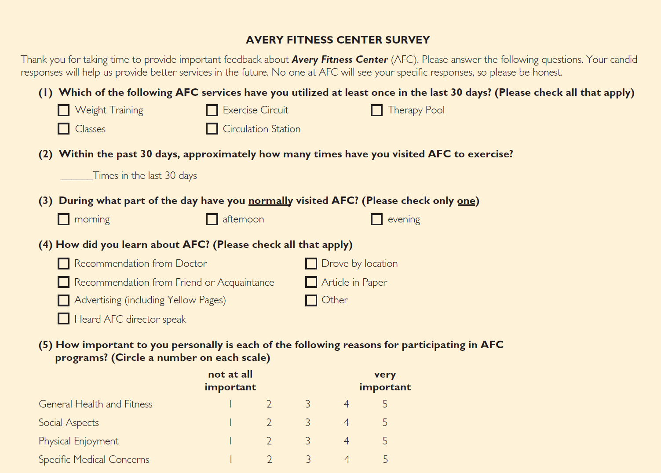
Avery Fitness Center Survey
How would you code each of these questions? Do you see any potential problems?

Slide 15
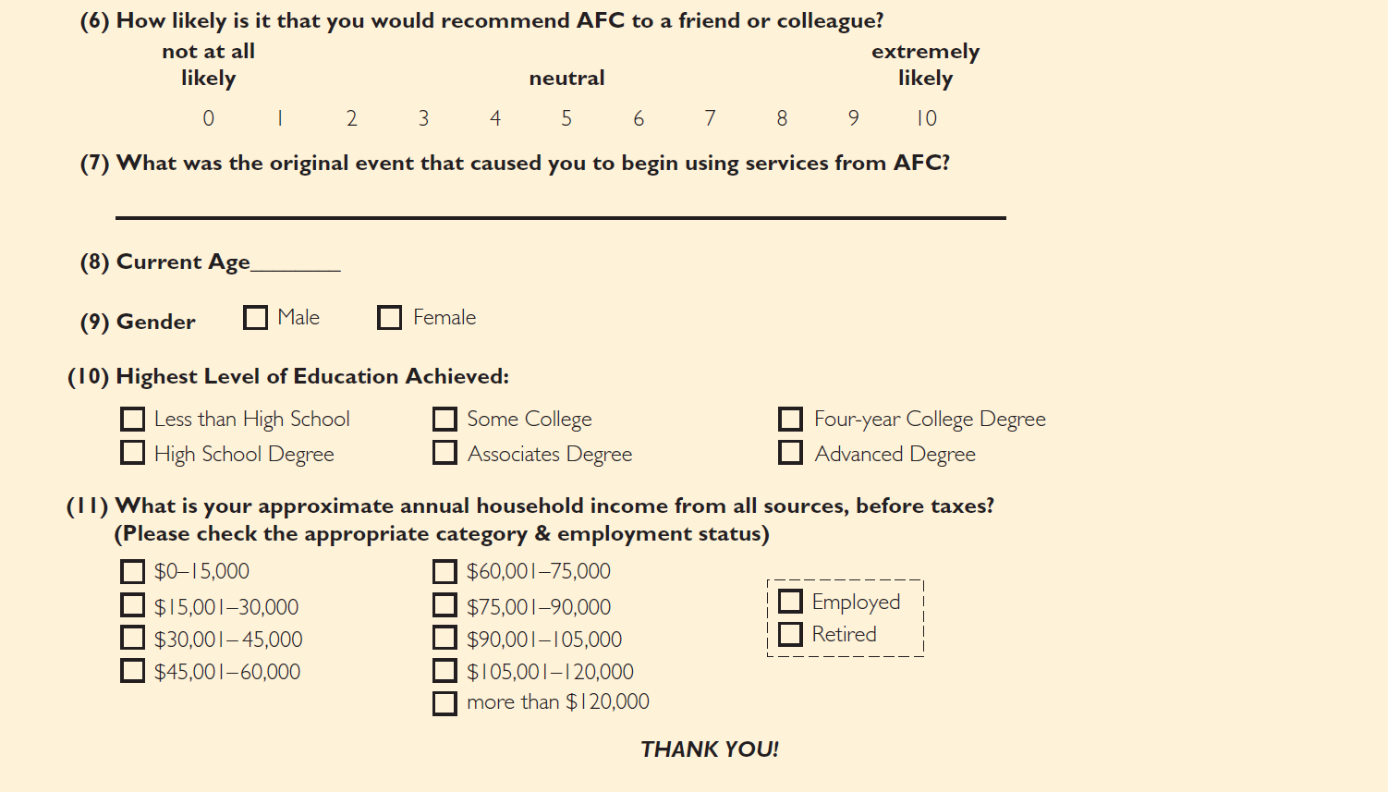
How would you code each of these questions? Do you see any potential problems?

Slide 16
CODEBOOK
A document that contains explicit directions about how data from data collection forms are coded in the data file.

Slide 17
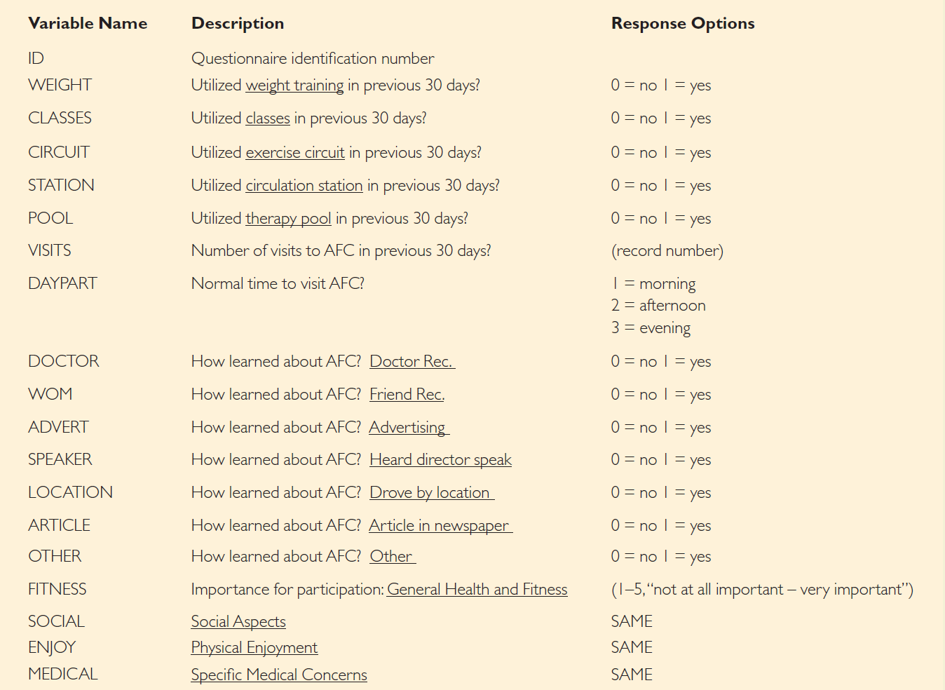
Developing a Codebook

Slide 18
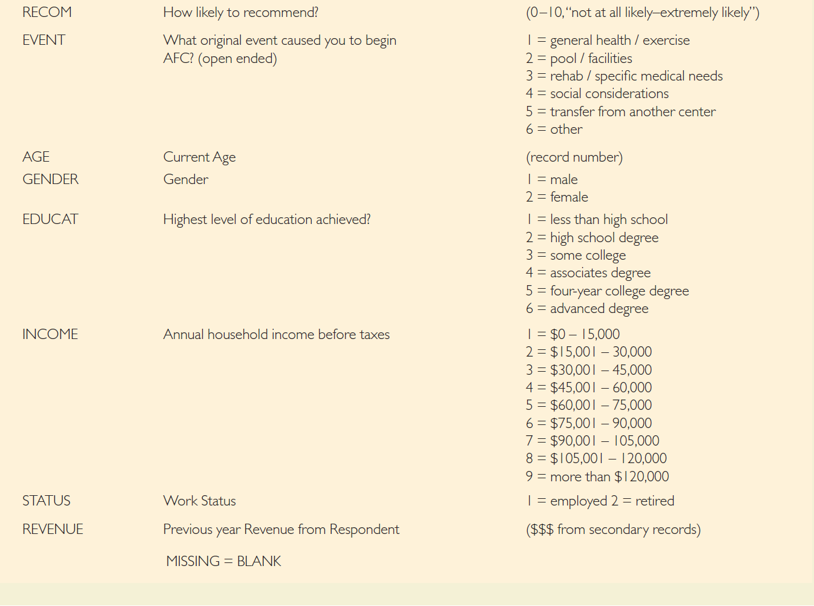

Slide 19
Cleaning the Data
BLUNDER
An error that arises during editing, coding, or data entry.
- blunders are usually due to researcher carelessness

Slide 20
How to identify blunders:
Run frequency analysis on all variables
Check a sample of questionnaires against the data file
Double-entry of data (preferred)
This is more of an issue when you use a paper survey and have to enter the data by hand. With Qualtrics we avoid this problem, but it is worth knowing about.

Slide 21
Dealing With Bad Respondents
Sometimes people will give you bad data:
Non response (next slide)
Rushing
Failing to understand instructions
Lazy
Deceptive
You cannot catch all cases but you should always be on the look out
What kinds of things might alert you to bad data?
If you identify a “bad respondent” you should eliminate them from analysis
IMPORTANT: Keep track of how many people you eliminate from analysis and why!!!!!

Slide 22
Handling Missing Data
ITEM NONRESPONSE
A source of error that arises when a respondent agrees to an interview but refuses, or is unable, to answer specific questions.
If a particular case has a significant amount of item nonresponse, it should probably be eliminated during the editing process.

Slide 23
Alternative Strategies for Handling Missing Data
Eliminate the case with the missing item(s) from all further analyses
Eliminate the case with the missing item in analyses using the variable
Substitute values for the missing items
Contact the respondent again

Slide 24
Notes for your projects
Keep track of:
How many respondent you had total (from your official start date after I give approval)
How many you eliminate from analysis
The reasons they are eliminated from analysis
Keep a document where you have
Respondent number
Reason for elimination

Slide 25
Analysis and Interpretation: Univariate (Individual Variables)

Slide 26
Quiz: Considerations
Quiz is worth 10% of your grade
Delivered in class
Use Canvas to take the quiz
Lockdown Browser will NOT be used
Similar format as previous quizzes
Material:
Decks 9-13
Focus is on collecting Primary Data and Survey Research
Know Sampling Types
Be able to calculate sample needed (i.e., Z-table, Qualtrics Sample Calculator, etc.)
Know Error Types

Slide 27



Do not edit How to change the design
Type of research in which the major emphasis is on determining cause-and-effect relationships.
The Slido app must be installed on every computer you’re presenting from

Slide 28
Do not edit How to change the design
Scientific investigation in which an investigator manipulates one or more independent variables and observes the degree to which the dependent variables change.
The Slido app must be installed on every computer you’re presenting from

Slide 29
Final Analysis: Considerations
Project is worth 20% of your grade
This is a GROUP project
Deliver Feedback via Qualtrics survey
Oral Presentation (10%)
Full participation
(25 for MKTG 302-01) minutes including rough copy of solution!
Written Report (10%)
Deliver
Objective/Aim
Methodology (would you do anything differently?)
Executive Summary
Key Findings (include Qualitative and Quantitative)
Recommendations – deliver a rough copy!

Slide 30
The Frequency Distribution of Whether to Recommend The Cincinnati Reds suggests ...
Source: Xavier University Proprietary Study, Spring, 2025
N = 133
CI = 90%
PROPRIETARY and CONFIDENTIAL

Slide 31
Cincinnati Reds have a Net Promoter Score of +4
Source: Xavier University Proprietary Study, Spring, 2025
N = 133
CI = 90%
PROPRIETARY and CONFIDENTIAL

Slide 32

Data Analysis: Two Key Considerations
(1) Is the variable to be analyzed by itself (univariate analysis) or in relationship to other variables (multivariate analysis)?
(2) What level of measurement was used?
If you can answer these two questions, data analysis is easy...

Slide 33
CATEGORICAL MEASURES
A commonly used expression for nominal and ordinal measures.
CONTINUOUS MEASURES
A commonly used expression for interval and ratio measures.

Slide 34
Types of Data
Categorical: Collected with respect to “category” variables such as demographics, etc. where we assign values to them (i.e., Male = 1, Female = 2, etc.)
Numerical: Collected as part of naturally occurring numerical values such as height and weight or age. Also known as Scale Data.

Slide 35
Types of Categorical Data
Nominal: QUALITATIVE data with no real numerical value (i.e., gender, etc.) where there’s no ranking or natural order.
Ordinal: QUALITATIVE data with a real numerical value (i.e., income, age, etc.) where ranking or natural order exists. Other examples include satisfaction levels, etc.

Slide 36
Types of Numerical Data
Interval: Collected with respect to “numerical” values such as Standardized Test Scores (inherent ordering)
Always expressed in numbers
Spaces between values are equal
Zero does not exist
Ratio: data that are ordered or ranked
Zero exists as meaningful

Slide 37
Basic Univariate Statistics: Categorical Measures
FREQUENCY ANALYSIS
A count of the number of cases that fall into each of the possible response categories.
…an incredibly common and useful type of analysis

Slide 38
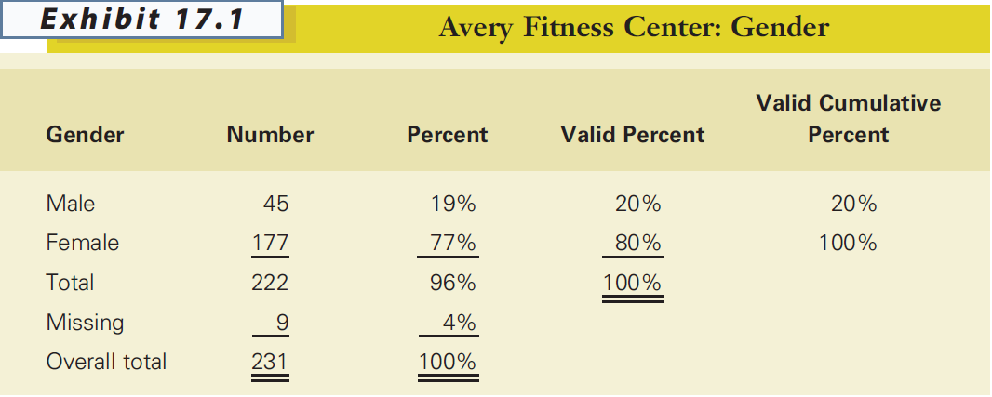

Slide 39
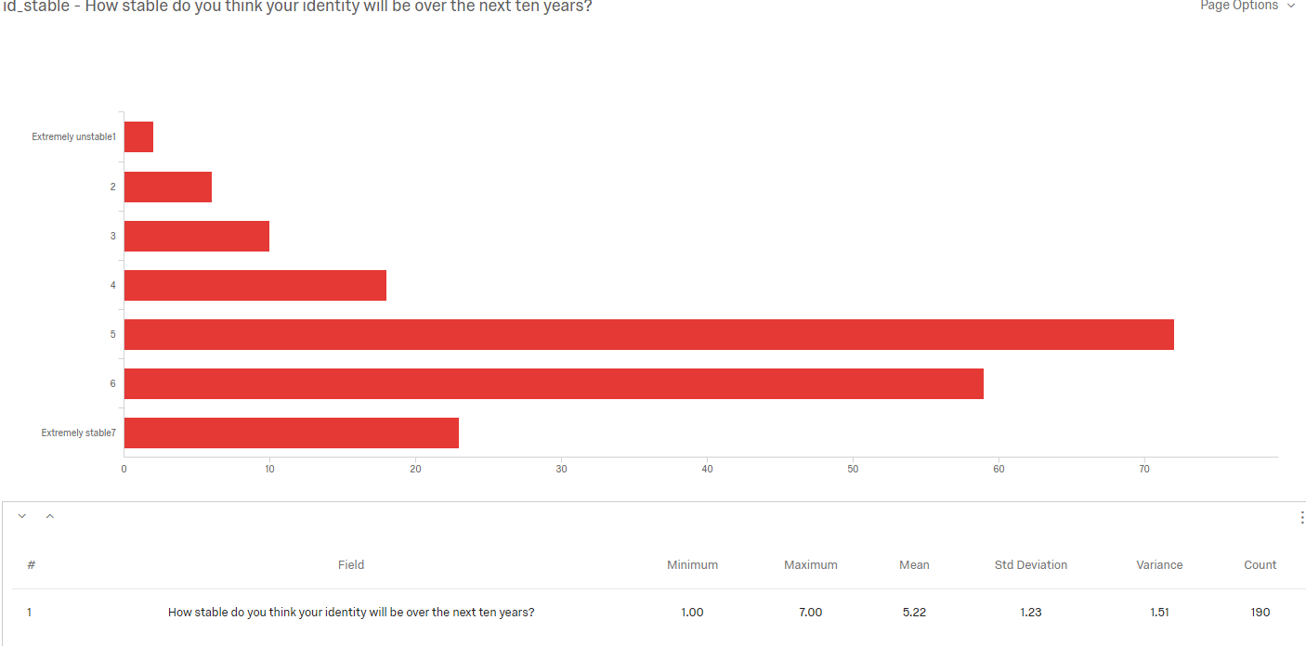
Qualtrics Generates this for you Automatically
In Qualtrics go to Reports, click on initial reports

Slide 40
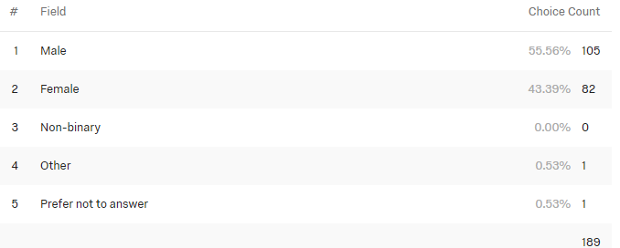
Use of Percentages
Percentages are very useful for interpreting the results of categorical analyses and should be included whenever possible.
Unless your sample size is VERY large, however, report percentages as whole numbers (i.e., no decimals)
To get these in Qualtrics:
On the Far Right, next to the output for a question, click on “Metric” select “Percentage”

Slide 41
Frequency Analysis
Researchers almost always work with “valid” percentages which are simply percentages after taking out cases with missing data on the variable being analyzed.

Slide 42
Presenting Frequency Analysis Results
GENDER number percent
male 45 20%
female 177 80%
total 222 100%
(missing = 9)

Slide 43
Uses of Frequency Analysis
Univariate categorical analysis
Identify blunders and cases with excessive item nonresponse
Identify outliers
Identify the median

Slide 44
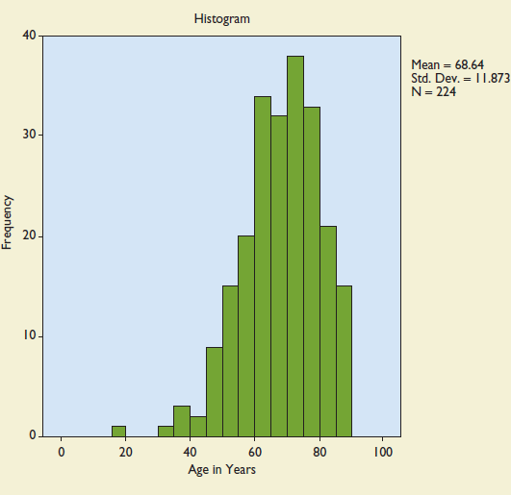
OUTLIER
An observation so different in magnitude from the rest of the observations that the analyst chooses to treat it as a special case.

Slide 45
HISTOGRAM
A form of bar chart on which the values of the variable are placed along the x-axis and the absolute or relative frequency of the values is shown on the y-axis.
Qualtrics also does this for you but you may need to ask for it. Simply click on “Add Visualization” and it will automatically create a bar chart (aka histogram) for you. You may need to specify your preferences.

Slide 46
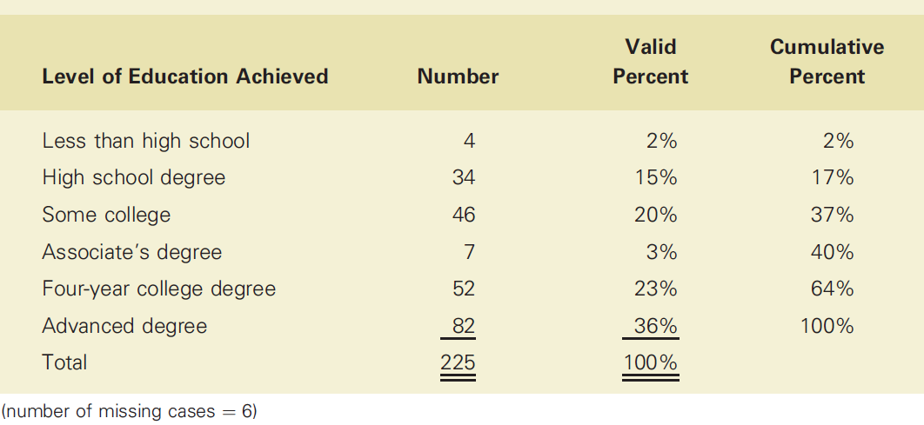
The MEDIAN level of education is found by identifying the level that contains the 50th percentile in the frequency distribution.
Your item must be ordinal or higher. Meaningless for nominal questions.

Slide 47
Basic Univariate Statistics: Continuous Measures
DESCRIPTIVE STATISTICS
Statistics that describe the distribution of responses on a variable. The most commonly used descriptive statistics are the mean and standard deviation.
Again, Qualtrics will do this for you automatically!
For your continuous measures it is most often appropriate to report the MEAN!

Slide 48
Converting Continuous Measures to Categorical Measures
Sometimes it is useful to convert continuous measures to categorical measures.
This is legitimate, because measures at higher levels of measurement (in this case, continuous measures) have all the properties of measures at lower levels of measurement (categorical measures).
Why do this? Ease of interpretation

Slide 49
COMMON APPROACHES
judgment
median split
cumulative % breakdowns
two-box technique

Slide 50
MEDIAN SPLIT
A technique for converting a continuous measure into a categorical measure with two approximately equal-sized groups. The groups are formed by “splitting” the continuous measure at its median value.

Slide 51
The MEDIAN level of education is found by identifying the level that contains the 50th percentile in the frequency distribution.

Slide 52
Using a median split will result in two education groups, a lower education group (64%; less than high school, high school degree, some college, associate’s degree, four-year college degree) and a higher education group (36%; advanced degree).
An alternative approach that would produce a more even split of AFC respondents would be to combine those with a four-year or advanced degree as the higher education group.
This might be useful for you on some of your usage questions. It is likely that high usage people behave differently than low usage. You will need to look at your data to determine what “high” and “low” mean in your sample.

Slide 53
CUMULATIVE PERCENTAGE BREAKDOWN
A technique for converting a continuous measure into a categorical measure. The categories are formed based on the cumulative percentages obtained in a frequency analysis.

Slide 54
If we wanted three approximately equal-sized education groups instead of six, we could use the cumulative percentage breakdown to construct the groups.
lower
medium
highest

Slide 55
TWO-BOX TECHNIQUE
A technique for converting an interval-level rating scale into a categorical measure, usually used for presentation purposes. The percentage of respondents choosing one of the top two positions on a rating scale is reported.

Slide 56
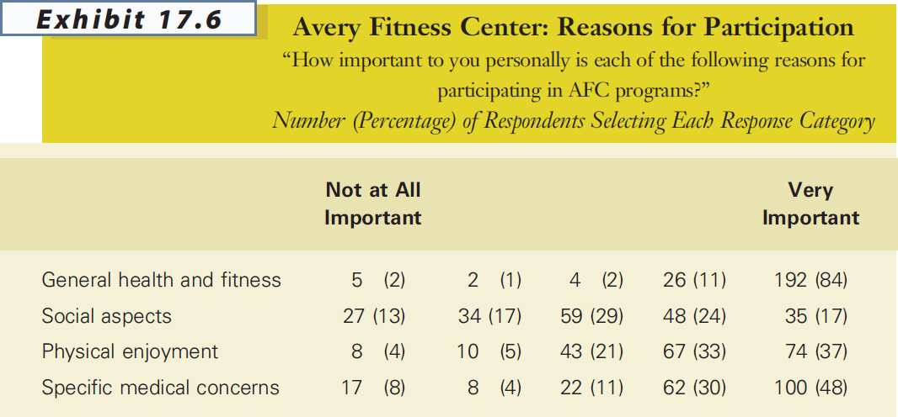

Slide 57
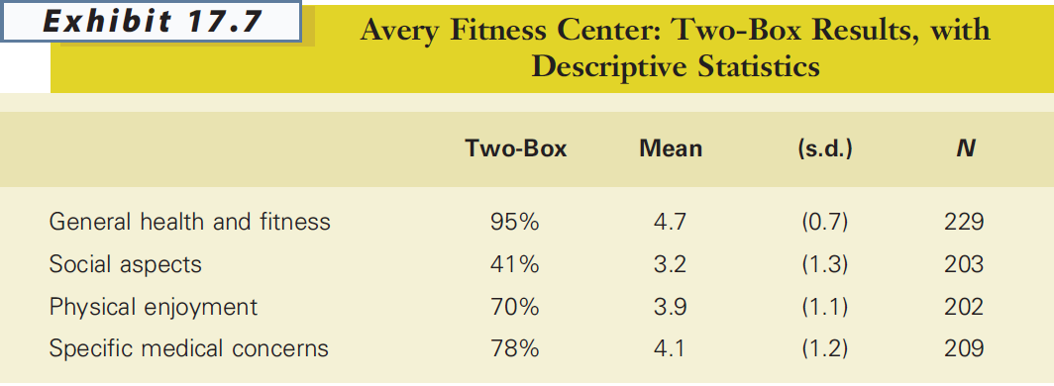

Slide 58
Now…
Go into qualtrics and start looking at your data
For now we are looking at univariate analysis (looking at the responses to each question individually)
You may want to start thinking about which pieces of information you will want to cover in your presentation

Slide 59

End of Information Covered on Quiz

Slide 60
Analysis and Interpretation: Multivariate (Multiple Variables Simultaenously)

Slide 61
Why Use Multivariate Analysis?
Multivariate analyses allow researchers a closer look at their data than is possible with univariate analyses.

Slide 62
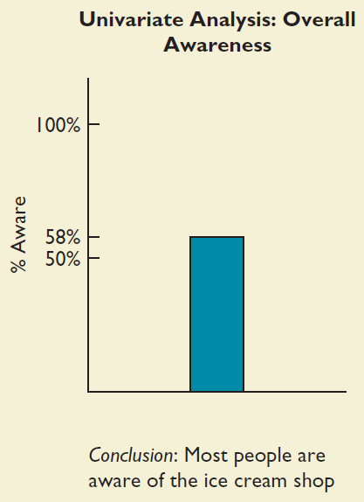
A Univariate Analysis Result

Slide 63
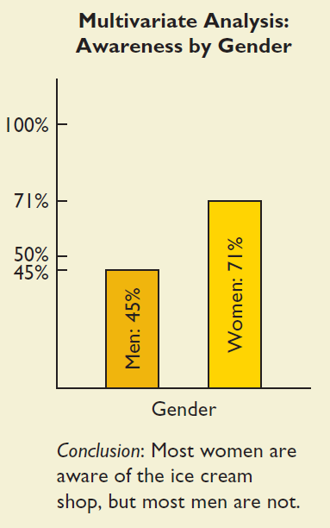
Multivariate Analysis Results: Enhanced Meaning

Slide 64
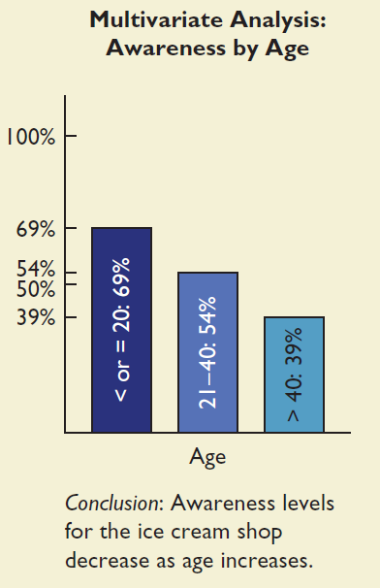
Multivariate Analysis Results: Enhanced Meaning

Slide 65
CROSS TABULATION
A multivariate technique used for studying the relationship between two or more categorical variables. The technique considers the joint distribution of sample elements across variables.

Slide 66
“Which Percentages Should I Use?”
Always calculate percentages in the direction of the causal variable.
Hint:
Which variable might have caused the other to occur?

Slide 67
Presenting the Results
Doctor Utilized Therapy Pool? Recommendation? No Yes total
No 107 70 177 (61%) (40%)
Yes 20 34 54
(37%) (63%)
total 127 104 231

Slide 68
Presenting Results Graphically
Which do you think is better? Why?

Slide 69
Presenting the Results
BANNER
A series of cross tabulations between an outcome, or dependent variable, and several (sometimes many) explanatory variables in a single table.

Slide 70
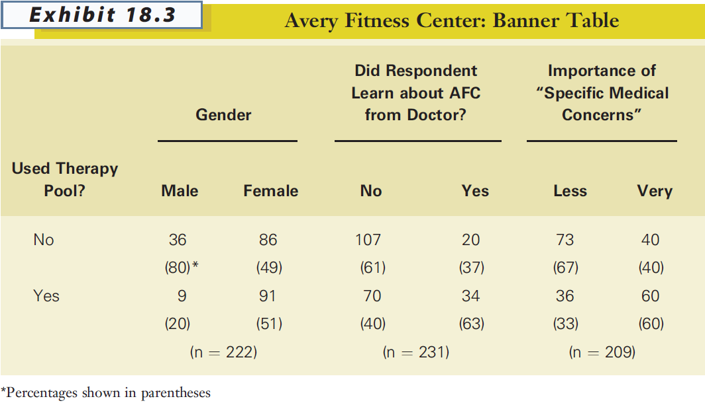
Presenting the Results

Slide 71
Cross-tabs: Testing for Statistical Significance
PEARSON CHI-SQUARE (χ²) TEST OF INDEPENDENCE
A commonly used statistic for testing the null hypothesis that categorical variables are independent of one another.

Slide 72
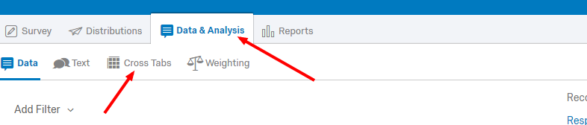
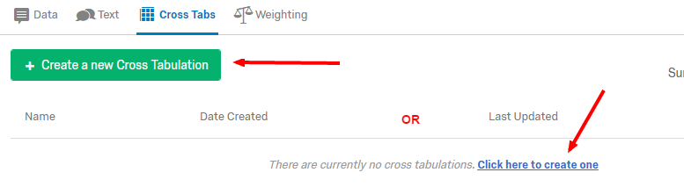
You can do this in Qualtrics!

Slide 73
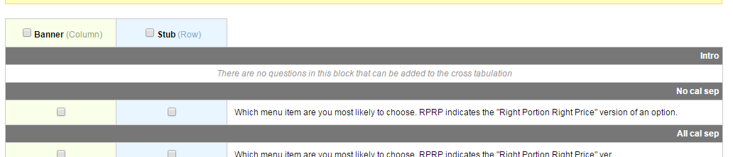
Creating the Cross-Tab
You will be give a screen with all your questions
For your Independent Variable (the thing you think causes a change in the Dependent Variable) select the blue box (Stub)
For your Dependent Variable select the pink box (Banner)
You can select multiple DVS for the same IV
Once you make selections, click on “Create Crosstabulation”

Slide 74
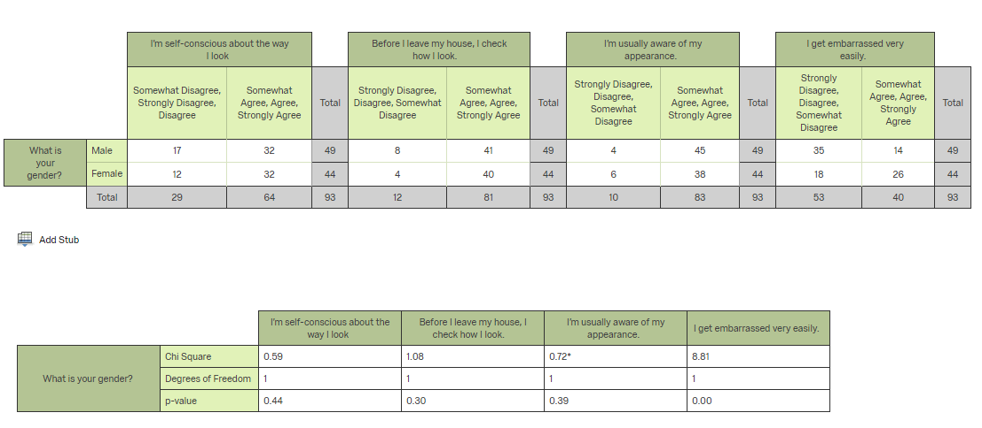
Output
If you have a continuous DV (as in example)
Try merging your answer choices to create a categorical DV

Slide 75
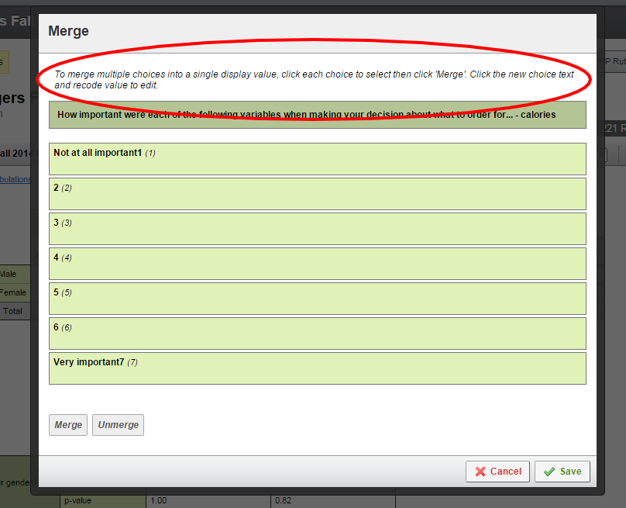
Merging
Move curser over title, you will get a little arrow.
Click on it
Select “Merge”

Slide 76
Lastly
Once you have created categories click “save”
Then “recalculate crosstab”

Slide 77
INDEPENDENT SAMPLES T-TEST FOR MEANS
A technique commonly used to determine whether two groups (categorical) differ on some characteristic assessed on a continuous measure.
EXAMPLES
Satisfaction ratings, men vs. women
Age in years, customers vs. noncustomers

Slide 78
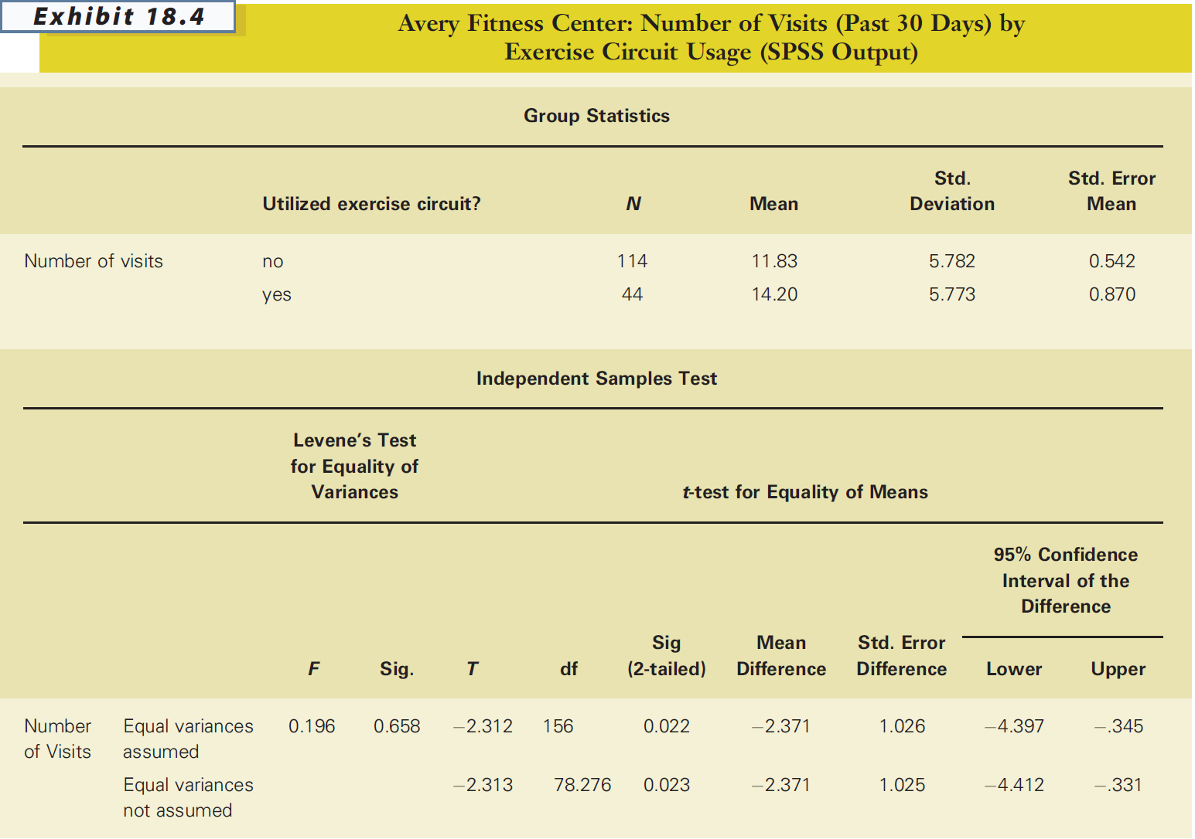
Does utilizing the exercise circuit (categorical independent variable) lead to increased number of visits to center (continuous dependent variable)?

Slide 79
PAIRED SAMPLE T-TEST
A technique for comparing two means (continuous) when scores for both variables are provided by the same sample.
EXAMPLES
Before and after measures
Applying same measure to different objects

Slide 80
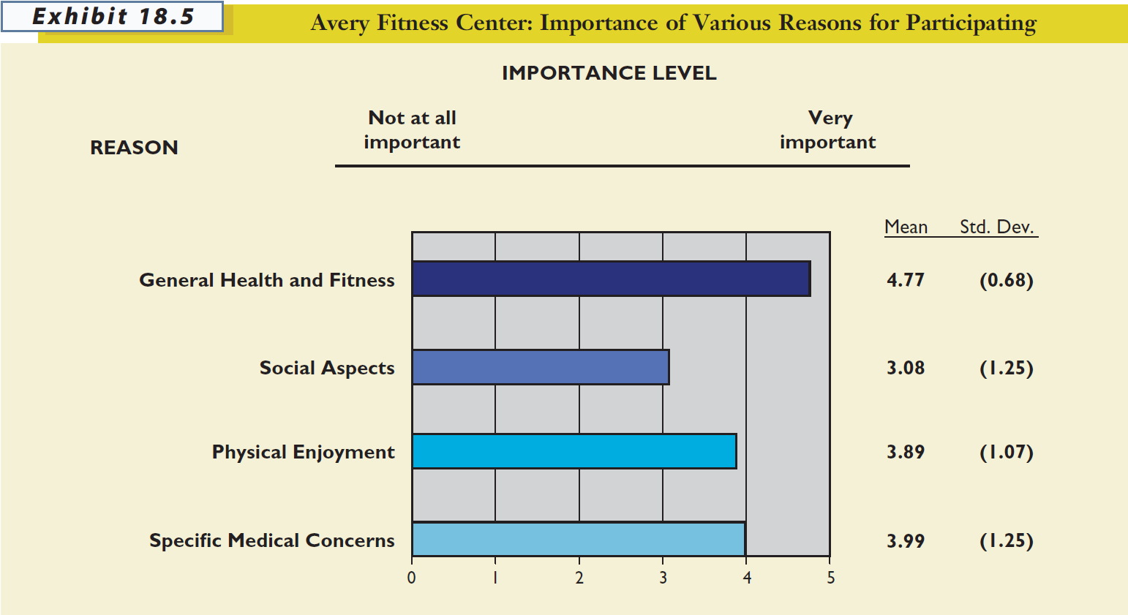

Slide 81
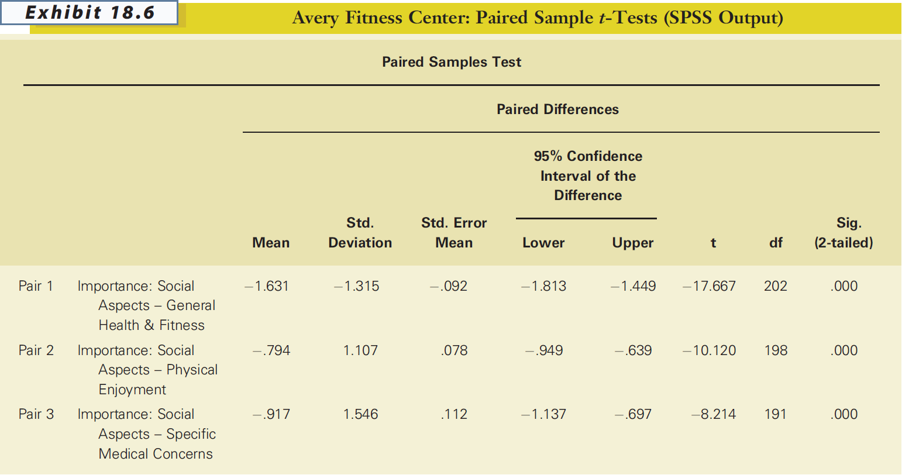
Do the mean attribute importance levels, provided by the same respondents, differ from one another?

Slide 82
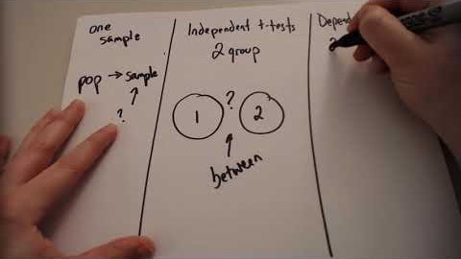
T-TEST
Notes:
0:00-1:29
Three Types of t Tests
https://youtu.be/4VdXSXfrBTw

Slide 83
PEARSON PRODUCT-MOMENT CORRELATION COEFFICIENT
A statistic that indicates the degree of linear association between two continuous variables. The correlation coefficient can range from -1 to +1.

Slide 84
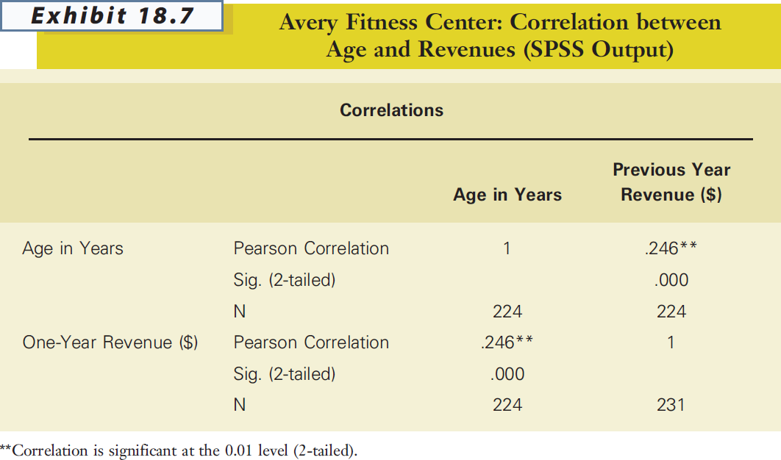
Is there a correlation between age (continuous independent variable) and fees paid (continuous dependent variable)?

Slide 85
REGRESSION ANALYSIS
A statistical technique used to derive an equation representing the influence of a single (simple regression) or multiple (multiple regression) independent variables on a continuous dependent, or outcome, variable.

Slide 86
QUESTION: What attributes are driving satisfaction/liking of your chosen brand among your respondents?
YOU NEED TO RUN THIS!

Slide 87
COEFFICIENT OF MULTIPLE DETERMINATION (R²)
A measure representing the relative proportion of the total variation in the dependent variable that can be explained or accounted for by the fitted regression equation.

Slide 88
Remember!
The goal of your project is to make recommendations to your client.
Those recommendations need to be based on your research
You will likely need to do a regression analysis for your final project.

Slide 89


